Slide 1
Results of the
2018 IEEE CEC Competition on Evolutionary Many-Objective Optimization
R. Cheng, M. Li, Y. Tian, X. Xiang, X. Zhang, S. Yang, Y. Jin, and X. Yao
2018 IEEE Congress on Evolutionary Computation, Rio de Janeiro, Brazil, July 8-13, 2018

Slide 2
Outline
Introduction
Entries
Results
Summary

Slide 3
Motivation
Optimization problems with more than three objectives (i.e. many-objective) pose great challenge to existing evolutionary algorithms for traditional multi-objective optimization
This competition aims at proposing 15 many-objective test problems with diverse properties, and investigating the performance of evolutionary algorithms on these problems [1]

Slide 4
Test problems
Test problem | Modified from | Difficulty
MaF1 | DTLZ1 [2] | Inverted PF
MaF2 | DTLZ2BZ [3] | Concurrent convergence
MaF3 | DTLZ3 [2] | Convex PF, multimodal
MaF4 | DTLZ3 [2] | Inverted and scaled PF, multimodal
MaF5 | DTLZ4 [2] | Scaled PF, highly biased distribution
MaF6 | DTLZ5(I,M) [4] | Degenerate PF
MaF7 | DTLZ7 [2] | Disconnected PF
MaF8 | MP-DMP [5] | Large search space
MaF9 | ML-DMP [6] | Large search space
MaF10 | WFG1 [7] | Complicated mixed PF
MaF11 | WFG2 [7] | Scaled disconnected PF
MaF12 | WFG9 [7] | Complicated fitness landscape
MaF13 | PF7 [8] | Degenerate PF, complicated variable linkage
MaF14 | LSMOP3 [9] | Complicated fitness landscape, large-scale
MaF15 | LSMOP8 [9] | Inverted PF, complicated fitness landscape, large-scale

Slide 5
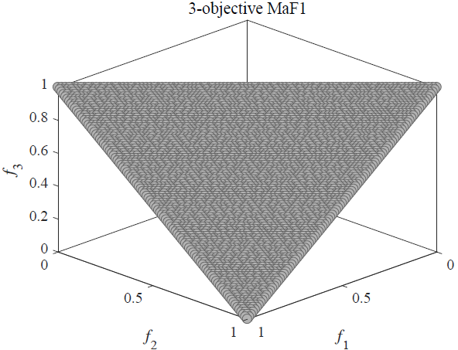
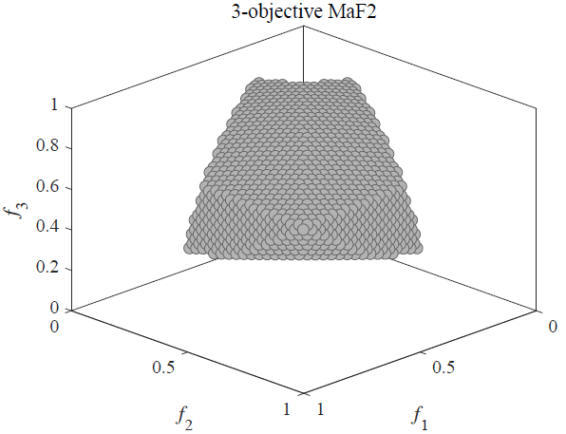
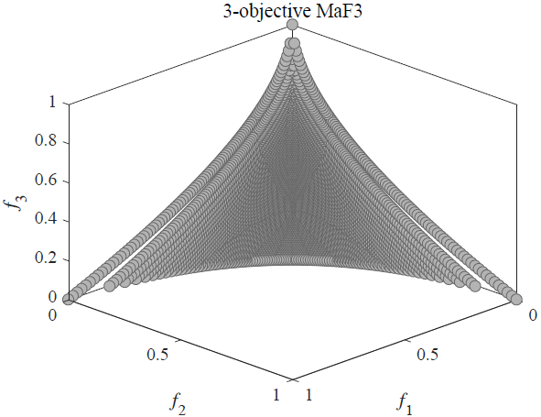
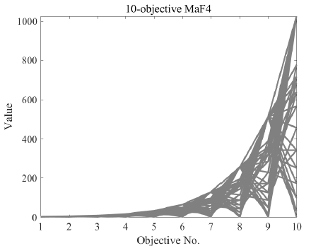
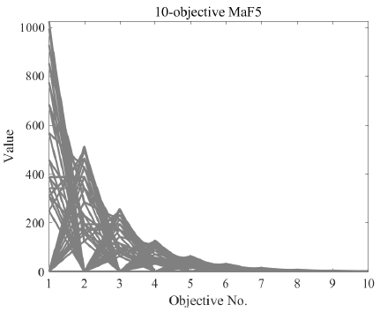
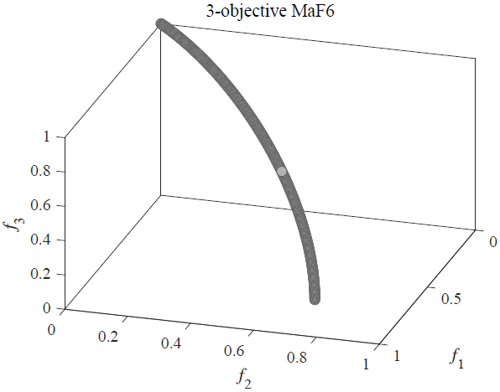
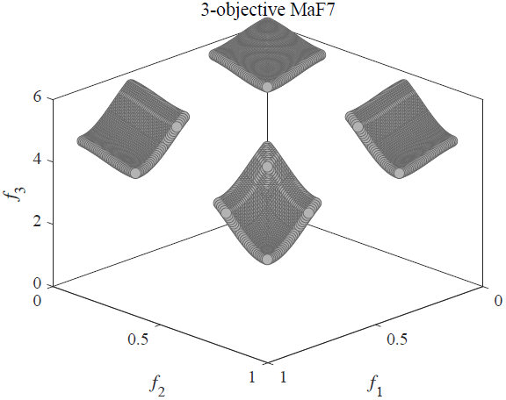
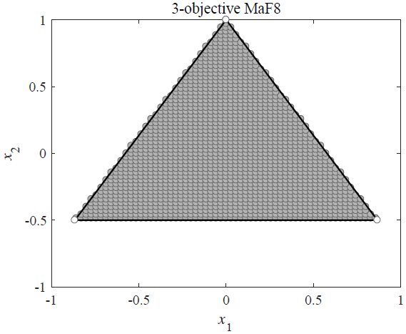
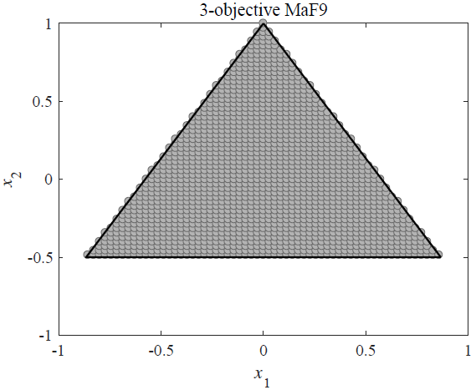
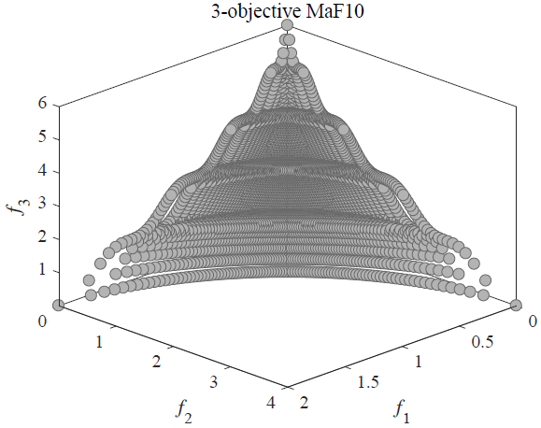
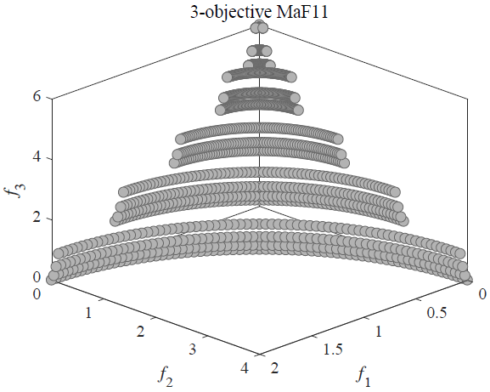
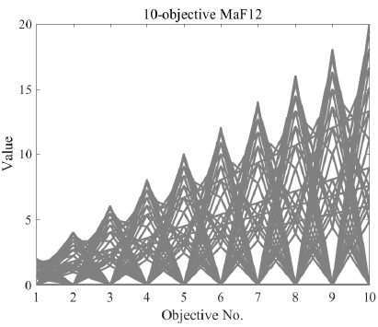
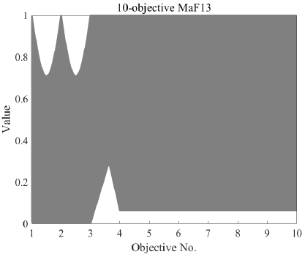
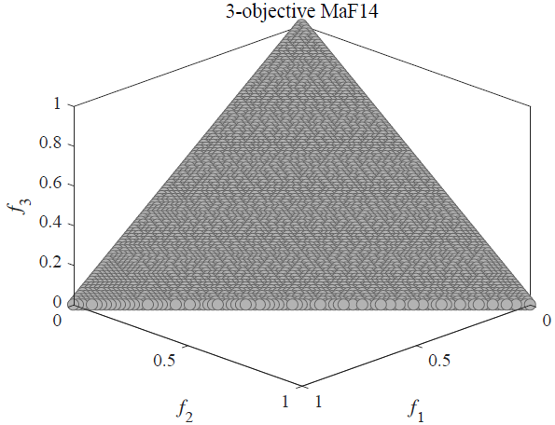
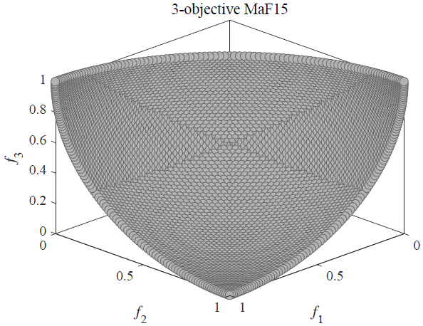
Pareto front of the test problems

Slide 6


Experimental platform
We provide the benchmark problems respectively embedded in two platforms
PlatEMO [10]: Open-source MATLAB platform
jMetal [11]: Open-source Java platform

Slide 7

About PlatEMO
PlatEMO includes more than 70 algorithms and 120 multi-objective test problems, which are all open-source and fully commented
PlatEMO provides friendly GUI for users to perform experiments and obtain experimental results in the format of L^{A}T_{E}X, without writing any code

Slide 8
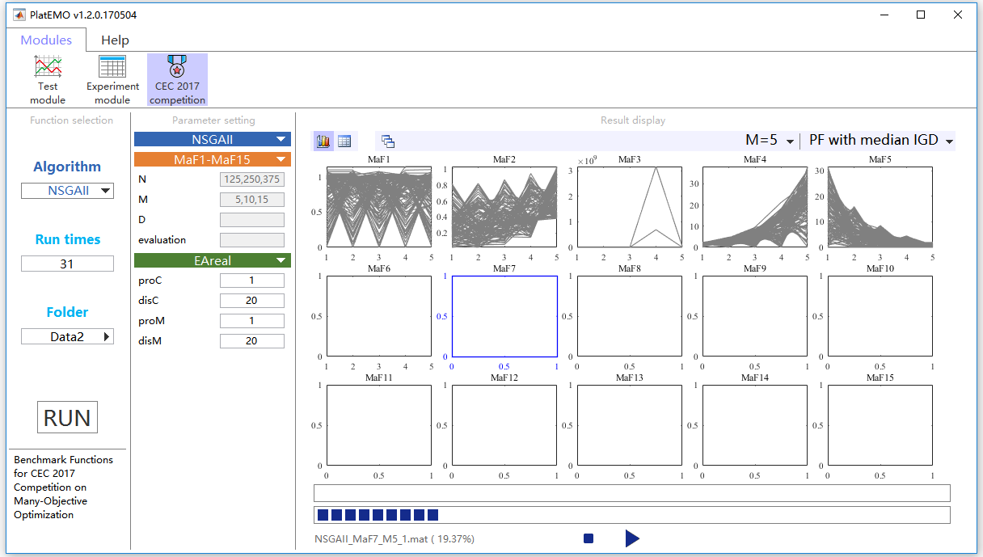
About PlatEMO
Specially tailored GUI for this competition – One click to obtain all the results.

Slide 9
Competition entries
Ten entries from four different countries
Four new algorithms
Six existing algorithms
Algorithm | Author | Description
AGE-II [12] | Markus Wagner | Approximation-guided evolution II
AMPDEA | Huangke Chen | Multi-population-driven evolutionary algorithm
BCE-IBEA [13] | Miqing Li | Bi-criterion evolution based IBEA
CVEA3 | Jiawei Yuan | Cost value based evolutionary algorithm 3
fastCAR | Mingde Zhao | Fast clustering based algorithm with reference point redistribution
HHcMOEA | Gian Fritsche | Hyper-heuristic collaborative MOEA
KnEA [14] | Xingyi Zhang | Knee point driven evolutionary algorithm
RPEA [15] | Yiping Liu | Reference points-based evolutionary algorithm
RSEA [16] | Cheng He | Radial space division based evolutionary algorithm
RVEA [17] | Ran Cheng | Reference vector guided evolutionary algorithm

Slide 10
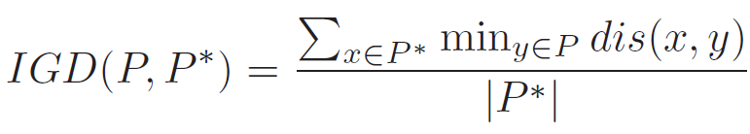

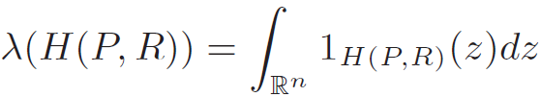
Performance indicators
Inverted generational distance (IGD) [18]
10,000 uniformly distributed reference points sampled on the Pareto front
Hypervolume (HV) [19]
Normalize the population by the nadir point of the Pareto front
Monte Carlo estimation method with 1,000,000 points is adopted

Slide 11
Ranking strategy
Each algorithm executes on each problem with 5, 10 and 15 objectives for 20 runs, respectively (i.e., 900 results)
Sort the means of each indicator value on each problem with each number of objectives (i.e., 90 ranks)
The SCORE achieved by each algorithm is the sum of the reciprocal values of the ranks.

Slide 12
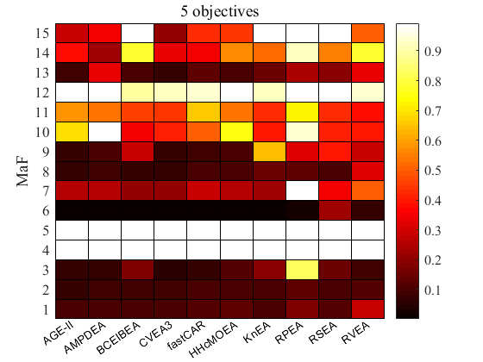
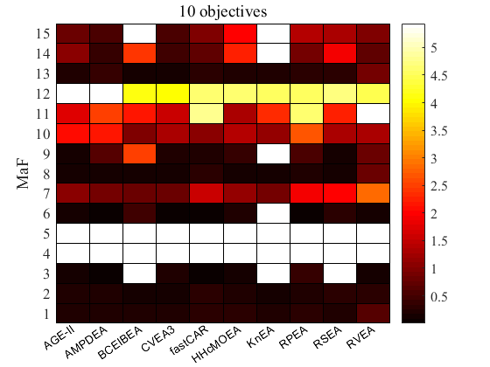
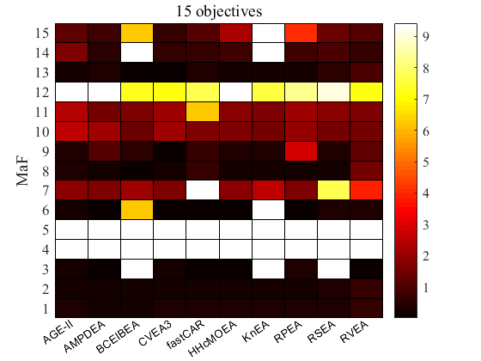
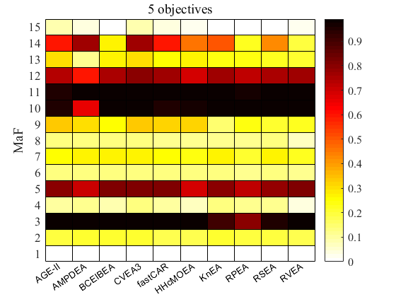
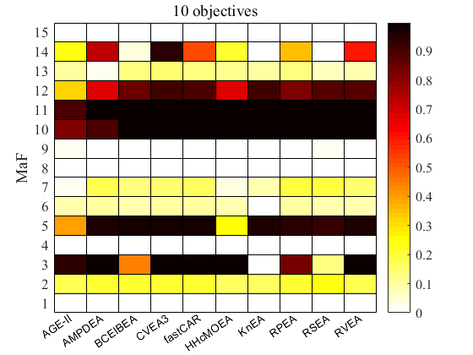
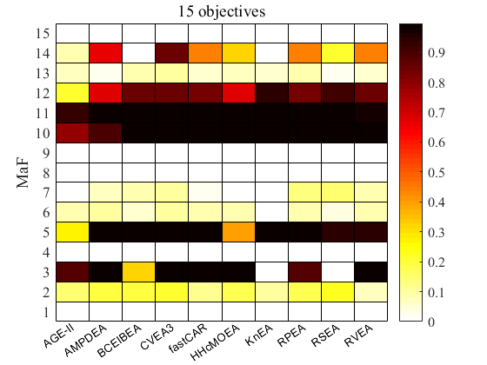
Overview of the Results
IGD values of the results (5-, 10- 15-ojective)
HV values of the results (5-, 10- 15-ojective)

Slide 13
Overview of the Ranks
Ranks according to IGD values
Ranks according to HV values
 | AGE-II | AMPDEA | BCE-IBEA | CVEA3 | fastCAR | HHcMOEA | KnEA | RPEA | RSEA | RVEA
MaF1 | 1 | 4 | 3 | 5 | 6 | 8 | 2 | 9 | 7 | 10
MaF2 | 1 | 2 | 3 | 4 | 7 | 5 | 6 | 10 | 8 | 9
MaF3 | 4 | 3 | 8 | 1 | 2 | 6 | 9 | 10 | 7 | 5
MaF4 | 9 | 2 | 3 | 1 | 4 | 7 | 6 | 5 | 8 | 10
MaF5 | 4 | 9 | 1 | 2 | 5 | 8 | 3 | 10 | 7 | 6
MaF6 | 5 | 4 | 1 | 2 | 7 | 6 | 3 | 8 | 10 | 9
MaF7 | 6 | 4 | 2 | 1 | 7 | 5 | 3 | 10 | 8 | 9
MaF8 | 1 | 4 | 2 | 3 | 6 | 5 | 9 | 8 | 7 | 10
MaF9 | 1 | 5 | 6 | 2 | 3 | 4 | 10 | 8 | 9 | 7
MaF10 | 7 | 10 | 1 | 5 | 6 | 8 | 3 | 9 | 4 | 2
MaF11 | 8 | 6 | 5 | 4 | 9 | 7 | 3 | 10 | 2 | 1
MaF12 | 6 | 10 | 1 | 2 | 4 | 9 | 3 | 8 | 7 | 5
MaF13 | 2 | 9 | 4 | 1 | 5 | 3 | 6 | 8 | 7 | 10
MaF14 | 4 | 1 | 8 | 2 | 3 | 7 | 5 | 10 | 6 | 9
MaF15 | 2 | 3 | 8 | 1 | 4 | 5 | 10 | 9 | 7 | 6
Total | 3 | 4 | 2 | 1 | 5 | 7 | 6 | 10 | 8 | 9
 | AGE-II | AMPDEA | BCE-IBEA | CVEA3 | fastCAR | HHcMOEA | KnEA | RPEA | RSEA | RVEA
MaF1 | 6 | 1 | 2 | 4 | 8 | 7 | 3 | 9 | 5 | 10
MaF2 | 7 | 5 | 3 | 2 | 8 | 4 | 1 | 6 | 10 | 9
MaF3 | 5 | 2 | 10 | 6 | 1 | 4 | 9 | 7 | 8 | 3
MaF4 | 9 | 1 | 6 | 2 | 4 | 8 | 5 | 3 | 7 | 10
MaF5 | 9 | 4 | 1 | 2 | 7 | 10 | 5 | 3 | 6 | 8
MaF6 | 5 | 2 | 9 | 1 | 4 | 7 | 10 | 3 | 8 | 6
MaF7 | 5 | 4 | 1 | 2 | 7 | 6 | 3 | 8 | 9 | 10
MaF8 | 2 | 6 | 1 | 3 | 9 | 4 | 5 | 8 | 7 | 10
MaF9 | 1 | 7 | 9 | 3 | 4 | 5 | 10 | 6 | 2 | 8
MaF10 | 8 | 9 | 1 | 6 | 2 | 7 | 3 | 10 | 5 | 4
MaF11 | 3 | 7 | 4 | 2 | 9 | 1 | 6 | 8 | 5 | 10
MaF12 | 10 | 9 | 2 | 1 | 6 | 7 | 5 | 4 | 8 | 3
MaF13 | 5 | 9 | 2 | 1 | 8 | 3 | 4 | 6 | 7 | 10
MaF14 | 6 | 1 | 9 | 2 | 4 | 8 | 10 | 5 | 7 | 3
MaF15 | 3 | 2 | 9 | 1 | 5 | 8 | 10 | 7 | 6 | 4
Total | 4 | 2 | 3 | 1 | 5 | 6 | 7 | 8 | 9 | 10
 | AGE-II | AMPDEA | BCE-IBEA | CVEA3 | fastCAR | HHcMOEA | KnEA | RPEA | RSEA | RVEA
MaF1 | 9 | 1 | 2 | 5 | 6 | 8 | 3 | 7 | 4 | 10
MaF2 | 6 | 1 | 8 | 2 | 7 | 5 | 3 | 4 | 9 | 10
MaF3 | 6 | 2 | 10 | 5 | 1 | 4 | 9 | 7 | 8 | 3
MaF4 | 8 | 1 | 5 | 3 | 6 | 10 | 4 | 2 | 7 | 9
MaF5 | 9 | 4 | 1 | 3 | 7 | 8 | 5 | 2 | 6 | 10
MaF6 | 6 | 2 | 9 | 1 | 4 | 3 | 10 | 5 | 8 | 7
MaF7 | 5 | 3 | 6 | 1 | 10 | 4 | 7 | 2 | 9 | 8
MaF8 | 8 | 3 | 1 | 2 | 9 | 4 | 5 | 6 | 7 | 10
MaF9 | 4 | 8 | 6 | 1 | 7 | 3 | 2 | 10 | 5 | 9
MaF10 | 10 | 9 | 1 | 8 | 5 | 6 | 3 | 7 | 4 | 2
MaF11 | 9 | 1 | 2 | 7 | 10 | 6 | 3 | 8 | 5 | 4
MaF12 | 9 | 10 | 3 | 1 | 5 | 8 | 4 | 6 | 7 | 2
MaF13 | 5 | 7 | 2 | 1 | 8 | 3 | 4 | 6 | 9 | 10
MaF14 | 8 | 1 | 9 | 2 | 4 | 5 | 10 | 6 | 7 | 3
MaF15 | 5 | 2 | 9 | 1 | 3 | 7 | 10 | 8 | 6 | 4
Total | 10 | 2 | 3 | 1 | 7 | 5 | 4 | 6 | 8 | 9
 | AGE-II | AMPDEA | BCE-IBEA | CVEA3 | fastCAR | HHcMOEA | KnEA | RPEA | RSEA | RVEA
MaF1 | 1 | 2 | 4 | 5 | 6 | 8 | 3 | 9 | 7 | 10
MaF2 | 7 | 4 | 3 | 1 | 8 | 10 | 2 | 6 | 5 | 9
MaF3 | 7 | 3 | 6 | 1 | 2 | 4 | 9 | 10 | 8 | 5
MaF4 | 6 | 5 | 8 | 1 | 7 | 9 | 2 | 3 | 4 | 10
MaF5 | 6 | 9 | 4 | 3 | 1 | 10 | 5 | 8 | 7 | 2
MaF6 | 2 | 4 | 1 | 3 | 6 | 7 | 5 | 9 | 8 | 10
MaF7 | 6 | 4 | 1 | 2 | 7 | 8 | 5 | 10 | 3 | 9
MaF8 | 1 | 4 | 3 | 2 | 6 | 7 | 8 | 9 | 5 | 10
MaF9 | 2 | 5 | 6 | 1 | 3 | 4 | 10 | 7 | 9 | 8
MaF10 | 8 | 10 | 3 | 1 | 9 | 7 | 4 | 5 | 2 | 6
MaF11 | 10 | 8 | 3 | 1 | 4 | 5 | 7 | 9 | 2 | 6
MaF12 | 7 | 10 | 5 | 1 | 3 | 9 | 2 | 8 | 6 | 4
MaF13 | 1 | 10 | 4 | 2 | 5 | 3 | 7 | 6 | 8 | 9
MaF14 | 4 | 2 | 8 | 1 | 3 | 6 | 5 | 9 | 7 | 10
MaF15 | 2 | 3 | 9 | 1 | 4 | 6 | 10 | 8 | 7 | 5
Total | 3 | 5 | 2 | 1 | 4 | 8 | 6 | 10 | 7 | 9
 | AGE-II | AMPDEA | BCE-IBEA | CVEA3 | fastCAR | HHcMOEA | KnEA | RPEA | RSEA | RVEA
MaF1 | 6 | 4 | 2 | 7 | 3 | 9 | 5 | 8 | 1 | 10
MaF2 | 8 | 4 | 6 | 3 | 5 | 9 | 10 | 2 | 1 | 7
MaF3 | 6 | 1 | 8 | 2 | 4 | 3 | 10 | 7 | 9 | 5
MaF4 | 8 | 3 | 9 | 2 | 7 | 6 | 4 | 5 | 1 | 10
MaF5 | 9 | 4 | 2 | 3 | 1 | 10 | 5 | 7 | 8 | 6
MaF6 | 6 | 1 | 9 | 2 | 3 | 5 | 10 | 4 | 7 | 8
MaF7 | 10 | 3 | 7 | 5 | 4 | 9 | 8 | 2 | 1 | 6
MaF8 | 4 | 5 | 3 | 2 | 9 | 7 | 6 | 8 | 1 | 10
MaF9 | 1 | 6 | 9 | 3 | 4 | 5 | 10 | 7 | 2 | 8
MaF10 | 10 | 9 | 6 | 1 | 3 | 7 | 5 | 4 | 2 | 8
MaF11 | 10 | 1 | 4 | 2 | 6 | 5 | 7 | 9 | 3 | 8
MaF12 | 10 | 9 | 6 | 1 | 3 | 8 | 2 | 7 | 4 | 5
MaF13 | 7 | 10 | 4 | 1 | 3 | 5 | 6 | 2 | 9 | 8
MaF14 | 6 | 2 | 8 | 1 | 4 | 7 | 10 | 5 | 9 | 3
MaF15 | 5 | 1 | 7 | 2 | 4 | 6 | 9 | 10 | 8 | 3
Total | 9 | 2 | 6 | 1 | 3 | 7 | 10 | 5 | 4 | 8
 | AGE-II | AMPDEA | BCE-IBEA | CVEA3 | fastCAR | HHcMOEA | KnEA | RPEA | RSEA | RVEA
MaF1 | 4 | 6 | 3 | 7 | 2 | 8 | 9 | 10 | 1 | 5
MaF2 | 7 | 4 | 3 | 2 | 8 | 6 | 9 | 5 | 1 | 10
MaF3 | 6 | 4 | 8 | 5 | 2 | 1 | 9 | 7 | 10 | 3
MaF4 | 5 | 9 | 8 | 2 | 6 | 3 | 4 | 10 | 1 | 7
MaF5 | 10 | 5 | 2 | 1 | 4 | 9 | 3 | 6 | 7 | 8
MaF6 | 7 | 1 | 8 | 2 | 4 | 5 | 10 | 3 | 9 | 6
MaF7 | 10 | 6 | 5 | 3 | 7 | 9 | 8 | 2 | 1 | 4
MaF8 | 8 | 2 | 5 | 3 | 10 | 6 | 4 | 7 | 1 | 9
MaF9 | 5 | 9 | 6 | 1 | 8 | 4 | 2 | 7 | 3 | 10
MaF10 | 10 | 9 | 7 | 1 | 6 | 3 | 8 | 4 | 2 | 5
MaF11 | 10 | 1 | 5 | 4 | 6 | 2 | 7 | 8 | 3 | 9
MaF12 | 10 | 9 | 5 | 4 | 7 | 8 | 1 | 6 | 2 | 3
MaF13 | 5 | 10 | 3 | 1 | 8 | 4 | 6 | 2 | 9 | 7
MaF14 | 8 | 2 | 9 | 1 | 4 | 6 | 10 | 5 | 7 | 3
MaF15 | 8 | 5 | 7 | 1 | 2 | 4 | 9 | 10 | 6 | 3
Total | 10 | 4 | 5 | 1 | 6 | 3 | 9 | 7 | 2 | 8

Slide 14



Winner Algorithms
Cost value based evolutionary algorithm 3
Jiawei Yuan, Hai-Lin Liu, and Fangqing Gu
Guangdong University of Technology, China
1
CVEA3
NEW
2
AMPDEA
NEW
Multi-population-driven evolutionary algorithm
Huangke Chen and Guohua Wu
National University of Defense Technology, China
3
BCE-IBEA
Bi-criterion evolution based IBEA
Miqing Li, Shengxiang Yang, and Xiaohui Liu
Brunel University, U. K.

Slide 15
Conclusion
15 many-objective test problems were proposed for this competition
10 many-objective evolutionary algorithms joined the competition
According to the final ranking based on IGD and HV metrics, the winner is CVEA3 (Cost value based evolutionary algorithm 3)

Slide 16
Future work
Re-organize this competition with further enhancements (C code, better computational efficiency, etc.)
Attract more effective algorithms to join the competition

Slide 17
Q & A
R. Cheng (ranchengcn@gmail.com) M. Li (limitsing@gmail.com)
Y. Tian (field910921@gmail.com) X. Xiang (xxs1394@163.com)
X. Zhang (xyzhanghust@gmail.com) S. Yang (syang@dmu.ac.uk)
Y. Jin (yaochu.jin@surrey.ac.uk) X. Yao (x.yao@cs.bham.ac.uk)
Competition Homepage: http://www.cs.bham.ac.uk/~chengr/CEC_Comp_on_MaOO/2018/webpage.html

Slide 18
References
[1] Cheng R, Li M, Tian Y, et al. A Benchmark Test Suite for Evolutionary Many-objective Optimization. Complex & Intelligent Systems, 3(1): 67-81, 2017.
[2] Deb K, Thiele L, Laumanns M, et al. Scalable test problems for evolutionary multiobjective optimization[M]. Springer London, 2005.
[3] Brockhoff D, Zitzler E. Objective reduction in evolutionary multiobjective optimization: Theory and applications[J]. Evolutionary Computation, 2009, 17(2): 135-166.
[4] Deb K, Saxena D. Searching for Pareto-optimal solutions through dimensionality reduction for certain large-dimensional multi-objective optimization problems[C]//Proceedings of the World Congress on Computational Intelligence (WCCI-2006). 2006: 3352-3360.
[5] Köppen M, Yoshida K. Substitute distance assignments in NSGA-II for handling many-objective optimization problems[C]//Evolutionary multi-criterion optimization. Springer Berlin/Heidelberg, 2007: 727-741.
[6] Li M, Grosan C, Yang S, et al. Multi-line distance minimization: A visualized many-objective test problem suite[J]. IEEE Transactions on Evolutionary Computation, 2017.
[7] Huband S, Hingston P, Barone L, et al. A review of multiobjective test problems and a scalable test problem toolkit[J]. IEEE Transactions on Evolutionary Computation, 2006, 10(5): 477-506.
[8] Saxena D K, Zhang Q, Duro J A, et al. Framework for many-objective test problems with both simple and complicated Pareto-set shapes[C]//International Conference on Evolutionary Multi-Criterion Optimization. Springer Berlin Heidelberg, 2011: 197-211.
[9] Cheng R, Jin Y, Olhofer M, et al. Test problems for large-scale multiobjective and many-objective optimization[J]. IEEE Transactions on Cybernetics, 2016.
[10] Tian Y, Cheng R, Zhang X, et al. PlatEMO: A MATLAB Platform for Evolutionary Multi-Objective Optimization[J]. IEEE Computational Intelligence Magazine, 2017, 12(4): 73-87.
[11] Durillo J J, Nebro A J. jMetal: A Java framework for multi-objective optimization[J]. Advances in Engineering Software, 2011, 42(10):760-771.
[12] Wagner M, Neumann F. A fast approximation-guided evolutionary multi-objective algorithm[C]//Proceedings of the 15th annual conference on Genetic and evolutionary computation. ACM, 2013: 687-694.
[13] Li M, Yang S, Liu X. Pareto or Non-Pareto: Bi-Criterion Evolution in Multiobjective Optimization[J]. IEEE Transactions on Evolutionary Computation, 2016, 20(5): 645-665.
[14] Zhang X, Tian Y, Jin Y. A knee point-driven evolutionary algorithm for many-objective optimization[J]. IEEE Transactions on Evolutionary Computation, 2015, 19(6): 761-776.
[15] Liu Y, Gong D, Sun X, et al. Many-objective Evolutionary Optimization Based on Reference Points[J]. Applied Soft Computing, 2016, 50.
[16] He C, Tian Y, Jin Y, et al. A Radial Space Division Based Evolutionary Algorithm for Many-Objective Optimization[J]. Applied Soft Computing, 2017, 61.
[17] Cheng R, Jin Y, Olhofer M, et al. A reference vector guided evolutionary algorithm for many-objective optimization[J]. IEEE Transactions on Evolutionary Computation, 2016, 20(5): 773-791.
[18] Zhou A, Jin Y, Zhang Q, et al. Combining model-based and genetics-based offspring generation for multi-objective optimization using a convergence criterion[C]//Evolutionary Computation, 2006. CEC 2006. IEEE Congress on. IEEE, 2006: 892-899.
[19] While L, Hingston P, Barone L, et al. A faster algorithm for calculating hypervolume[J]. IEEE transactions on evolutionary computation, 2006, 10(1): 29-38.

